Slide 1
Spur:
Lo-fi Prototyping and usability
Hannah Cussen, Simran Tandon, Nils Forstall, Bhavya Shah

Slide 2
Spur.
Activities without the activation energy.

Slide 3
Spur is for…
We solve this by…
The time in your day when you're stuck scrolling on your phone, knowing that you should do something different but not knowing exactly what to do.
Thinking of an activity to do can be a drag, and planning one is such a headache. Both of which keep you scrolling and stuck in a rut.
Lowering the activation energy to find and plan an activity.
Browse suggested activities
Get information on details like location, time, and price
See which of your friends are interested in activities and invite them to do one!

Slide 4
Roadmap
01
02
03
04
Sketching Explorations
Selected interface
Lo-Fi Prototype
Testing

Slide 5
Sketching
Exploration
01

Slide 6
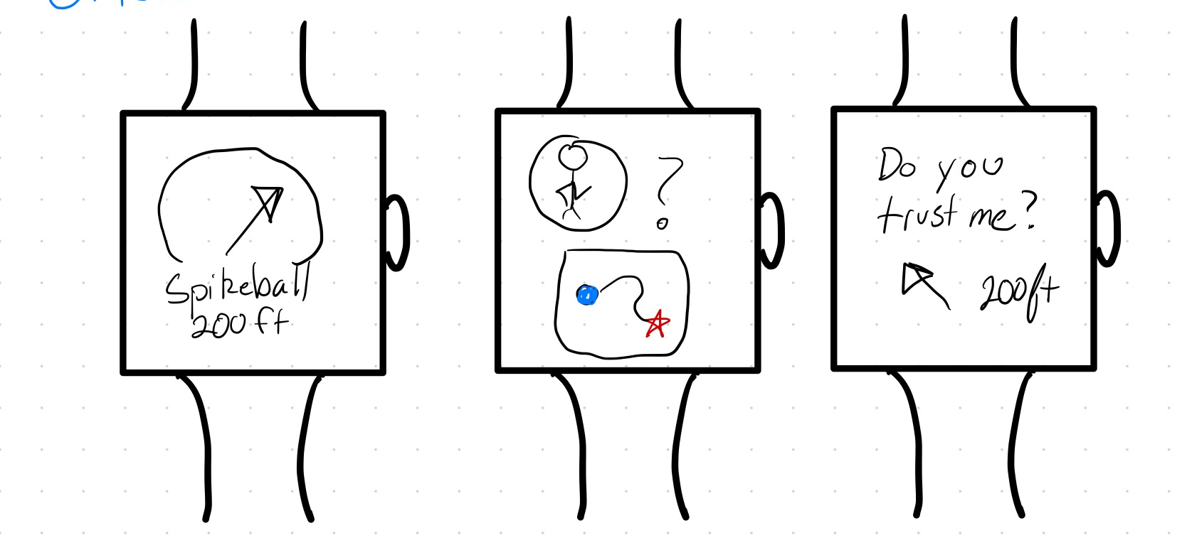
Wearable

Slide 7
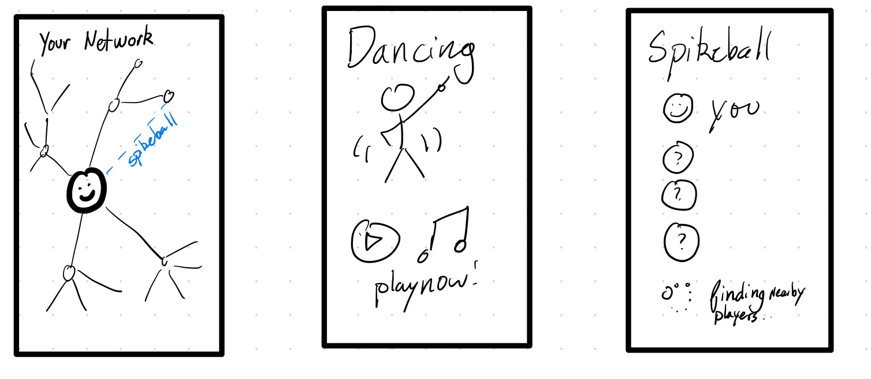
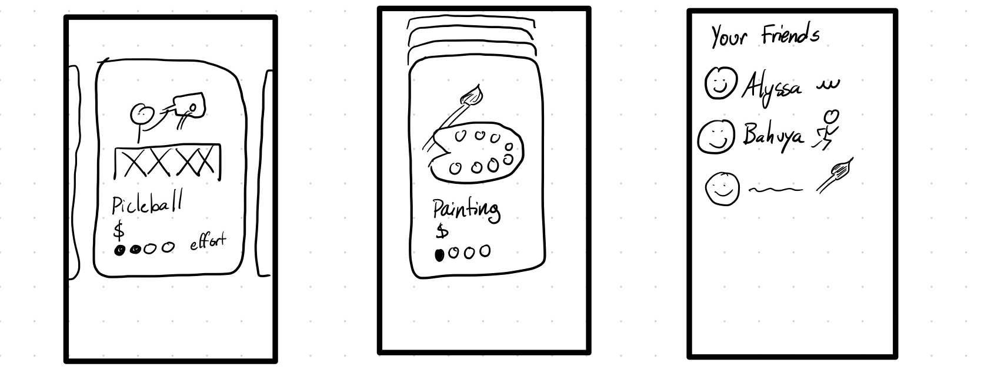
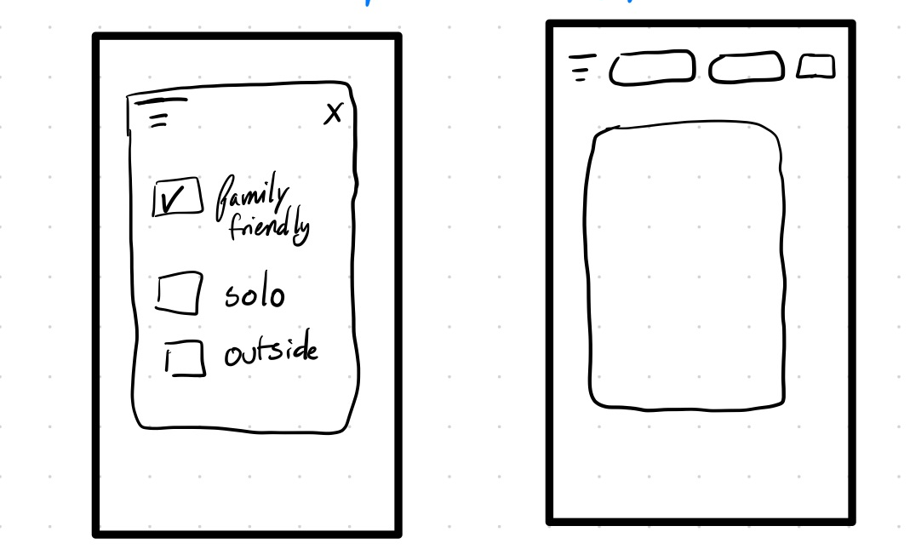
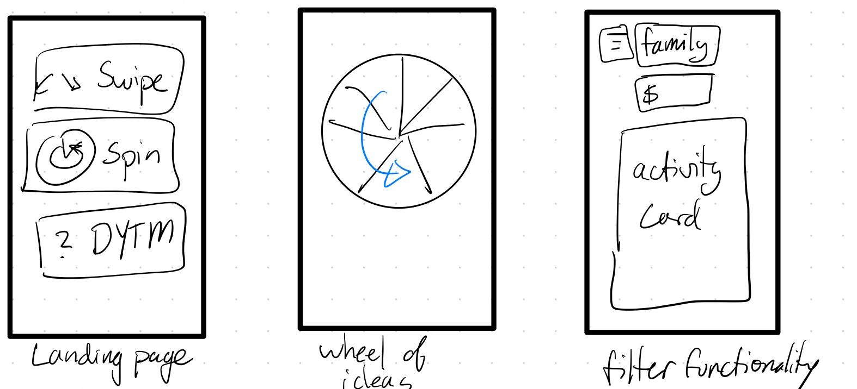
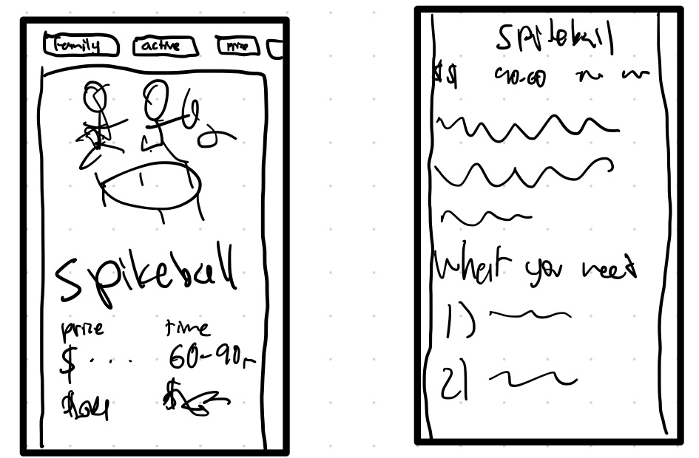
Native App

Slide 8
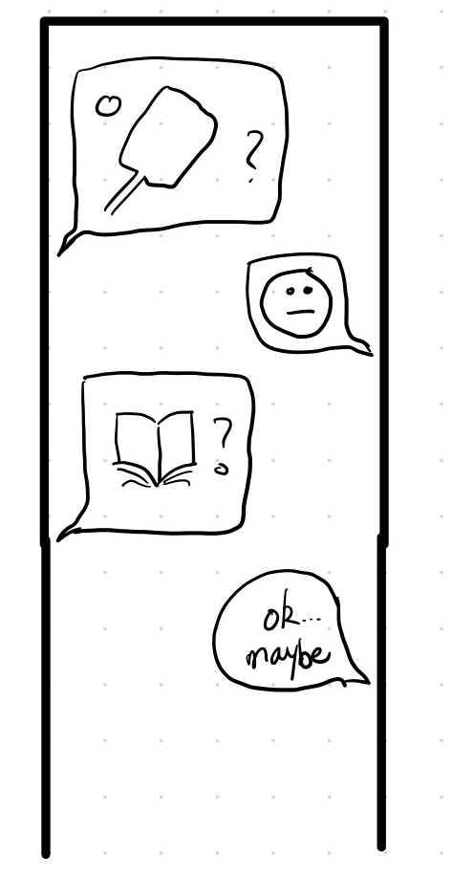
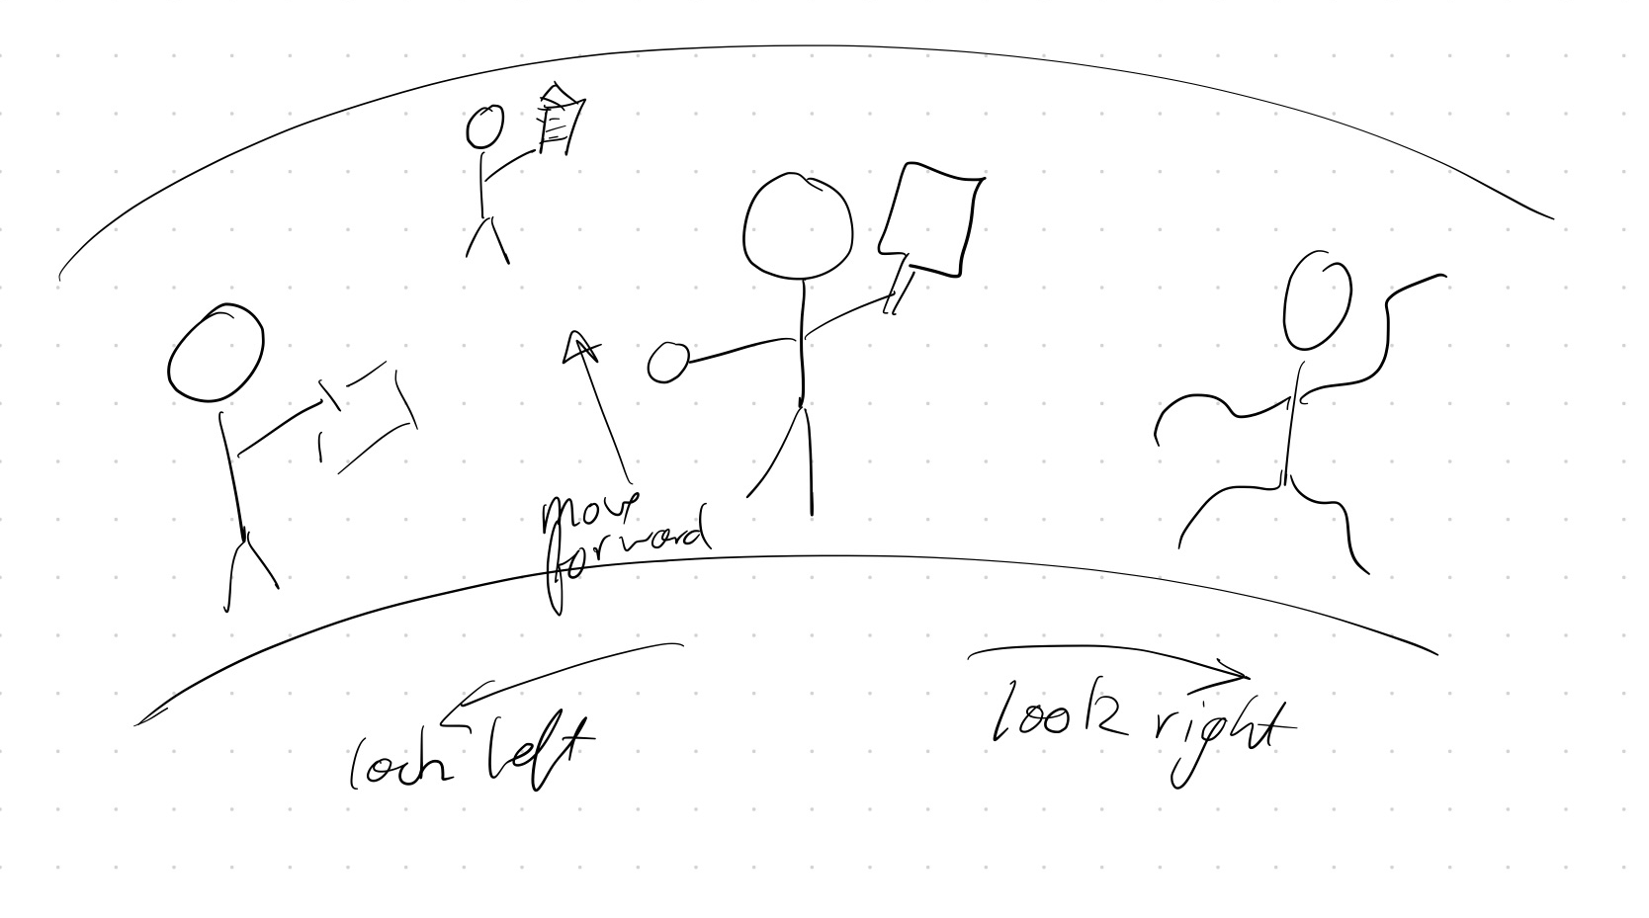
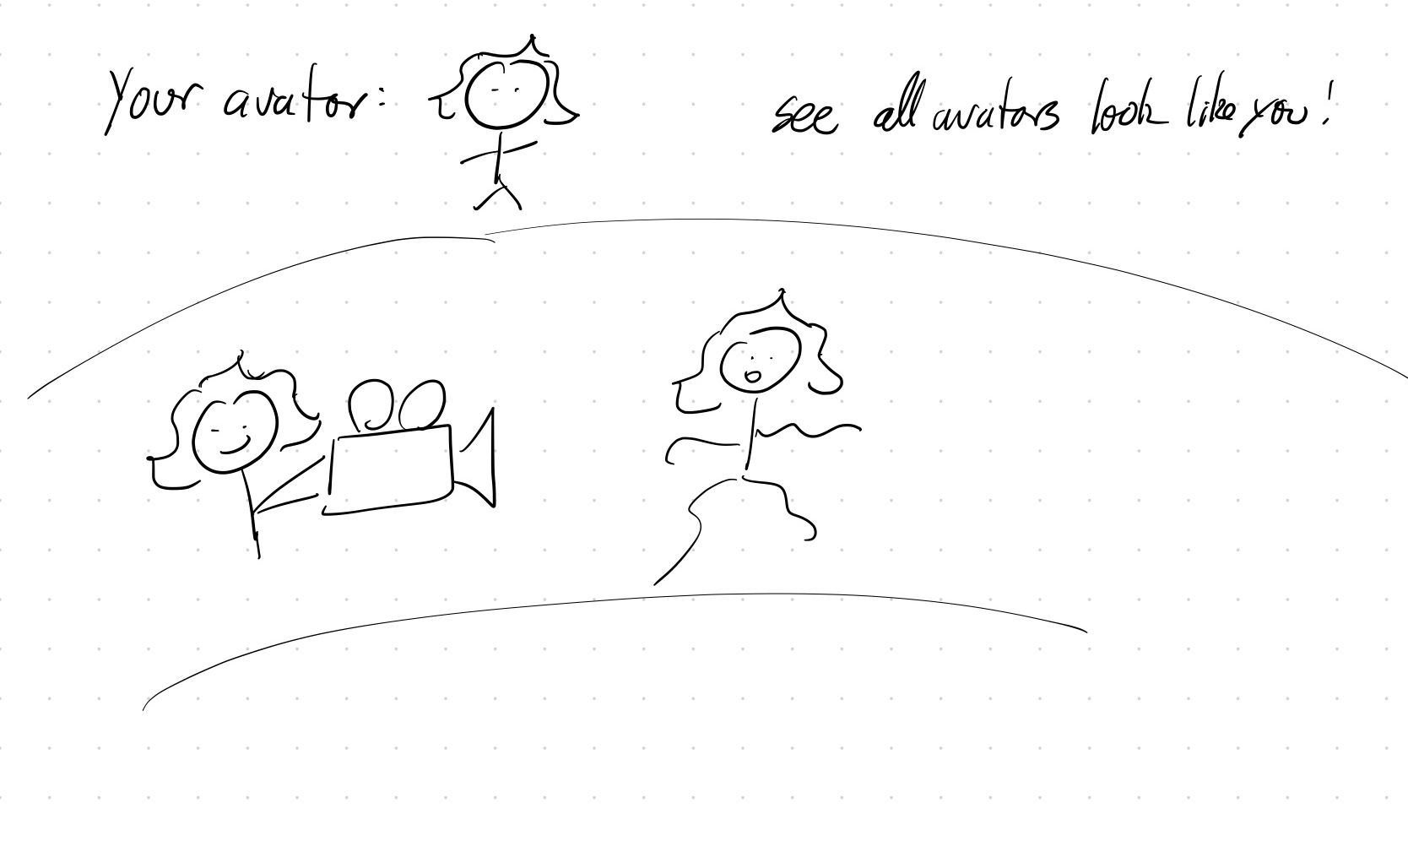
Chat-Based Interface
VR

Slide 9
Selected
Interfaces
02

Slide 10
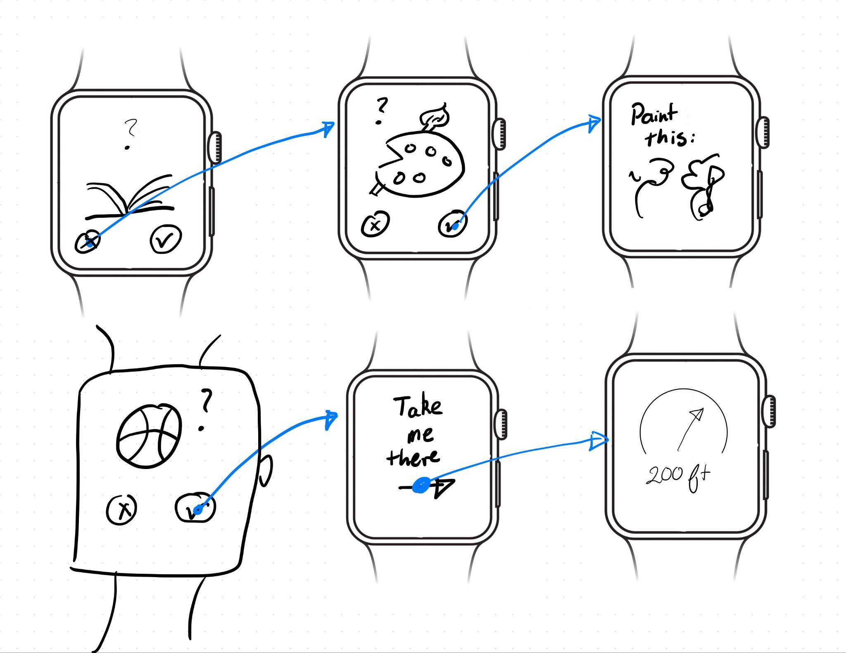
Further Exploration of Wearable

Slide 11
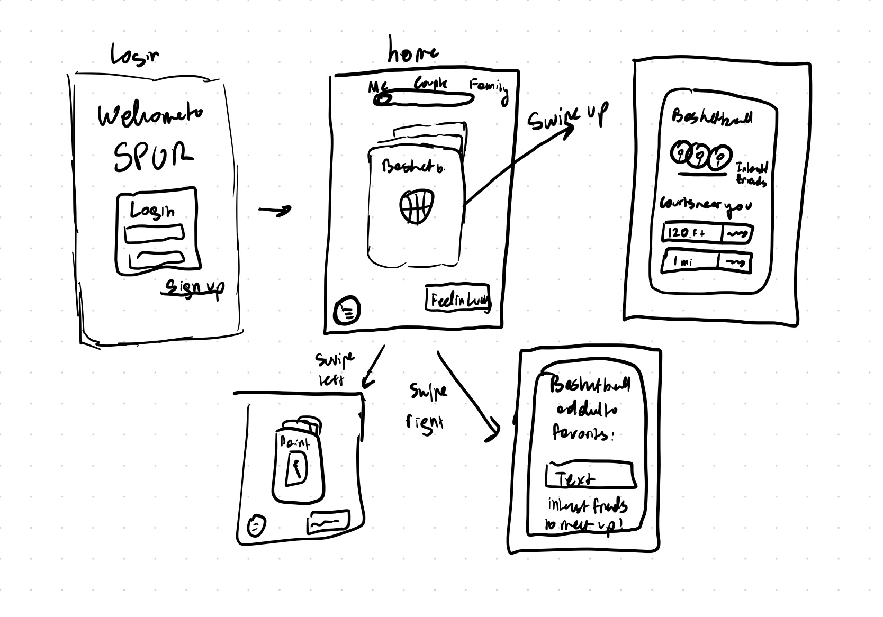
Further Exploration of Native app

Slide 12
Wearable
Pros
Cons
sense of delight for the idea of being led by your watch somewhere
Your watch is a timekeeper - this app is meant to help you spend time better
Smaller interface enforces simplicity
Less addictive
Limited reach since fewer people have smart watches
people waste free time on their phones, not watches, so we wouldn't be able to deliver our product at the time when it would be most valuable

Slide 13
Native App
Pros
Cons
larger area to show high-quality images of the activity, increasing engagement with the activity
people waste free time on their phones, so we can deliver our product at the time when it would be most valuable
We are more confident in our ability to implement a native app
People already spend too much time on their phones - do we want to contribute to that?
Swiping is addictive. How can we encourage people to put down the phone and engage with a selected activity?
People may be interrupted by other apps
Larger screen size means we may over-design the app

Slide 14
We will build a native app!

Slide 15
Lo-Fi Prototype:
Construction
3.1

Slide 16
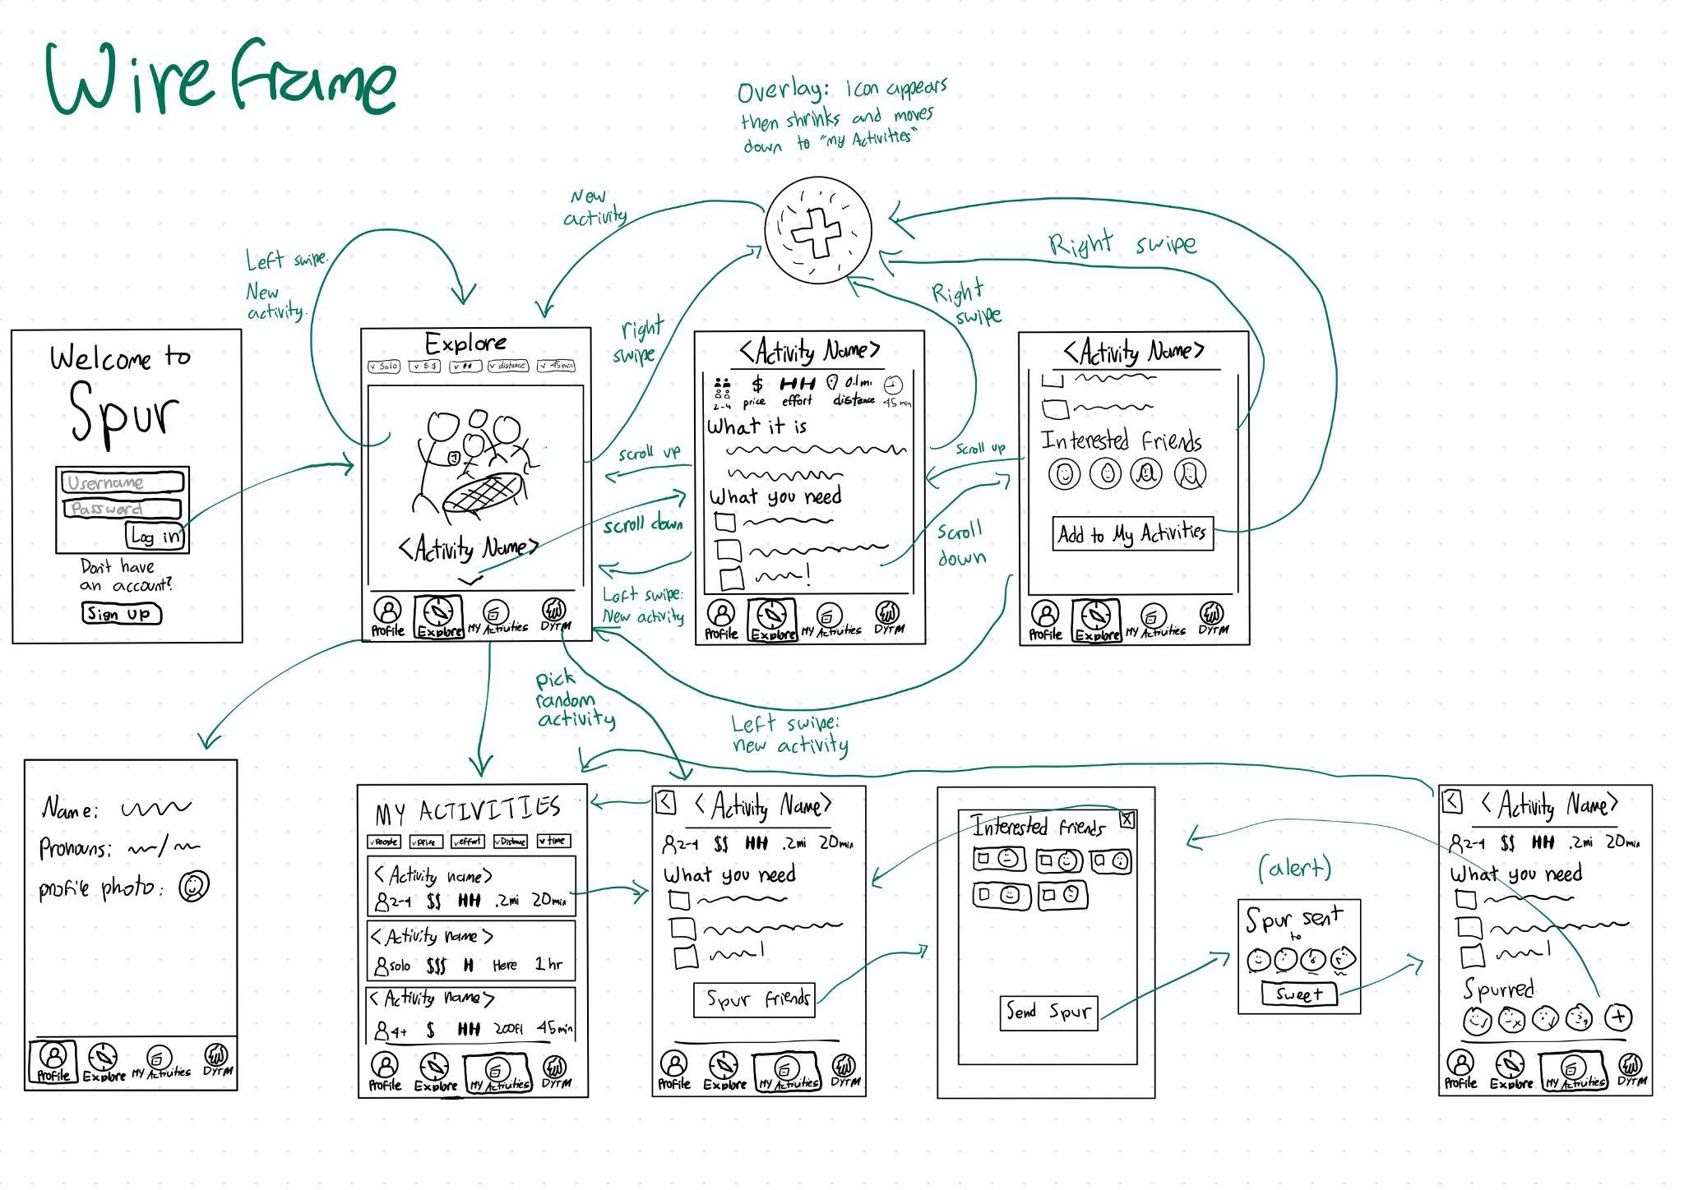
Wireframe overview of app

Slide 17
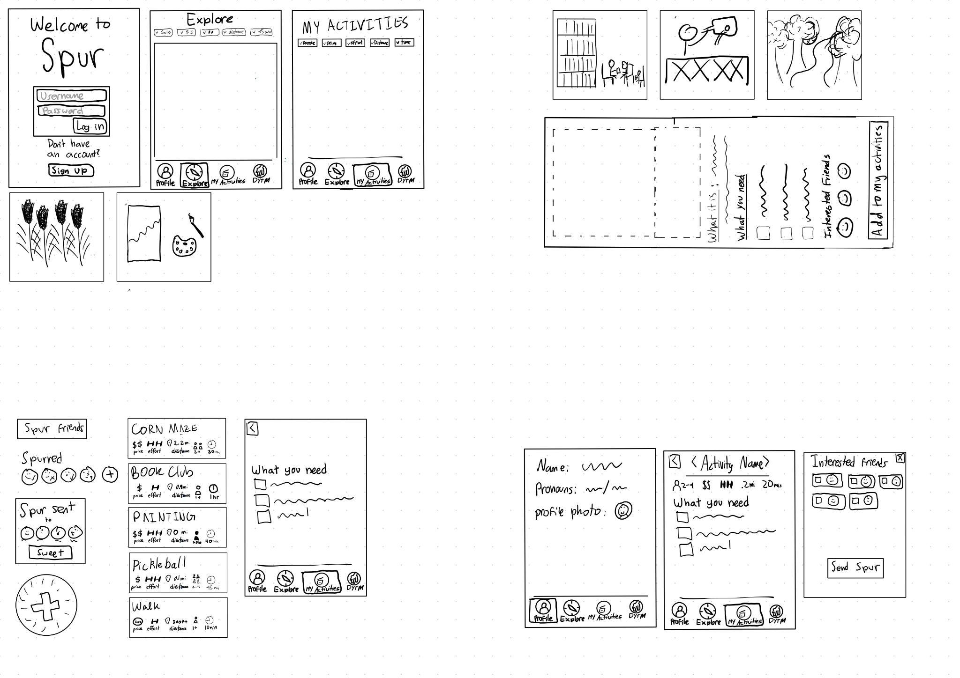
Wireframe split into components

Slide 18
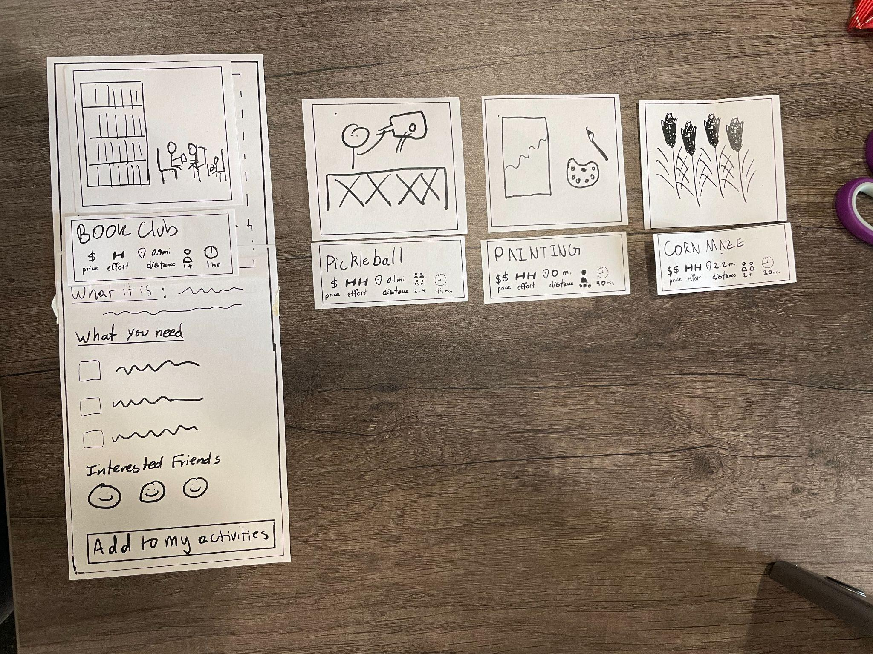
Interchangeable activity cards

Slide 19

Scrolling & Swiping Functionality

Slide 20
Lo-Fi Prototype:
3 Task Flows
3.2

Slide 21
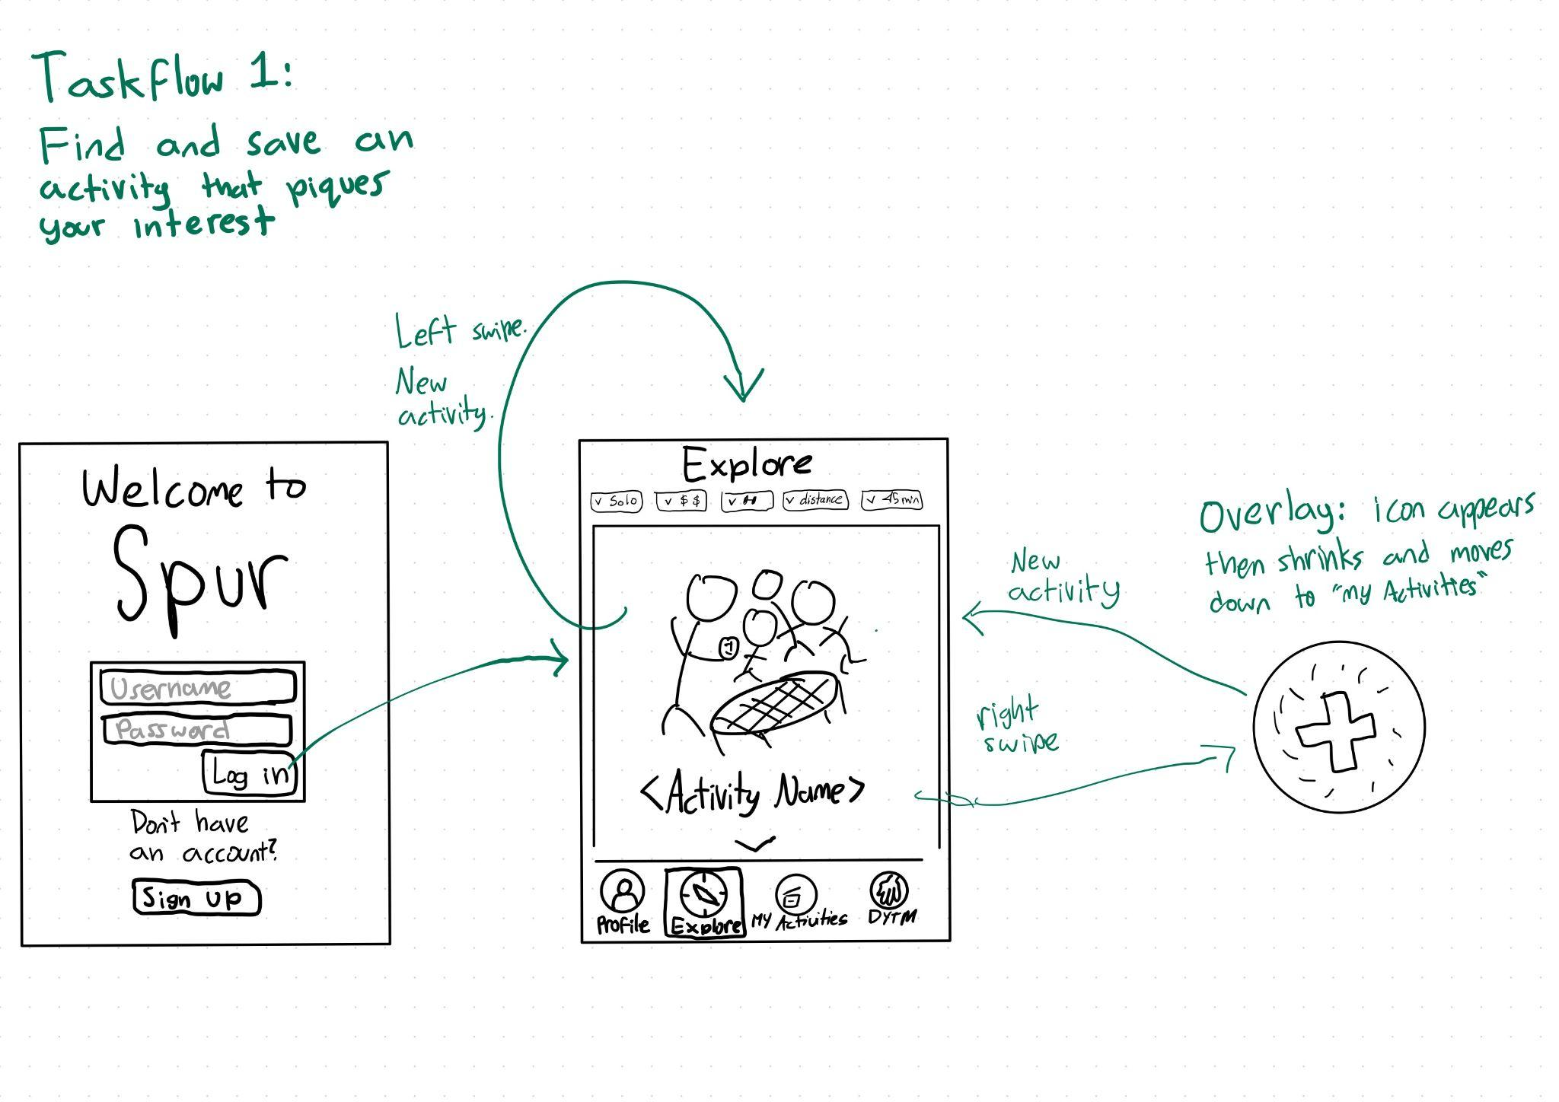

Slide 22
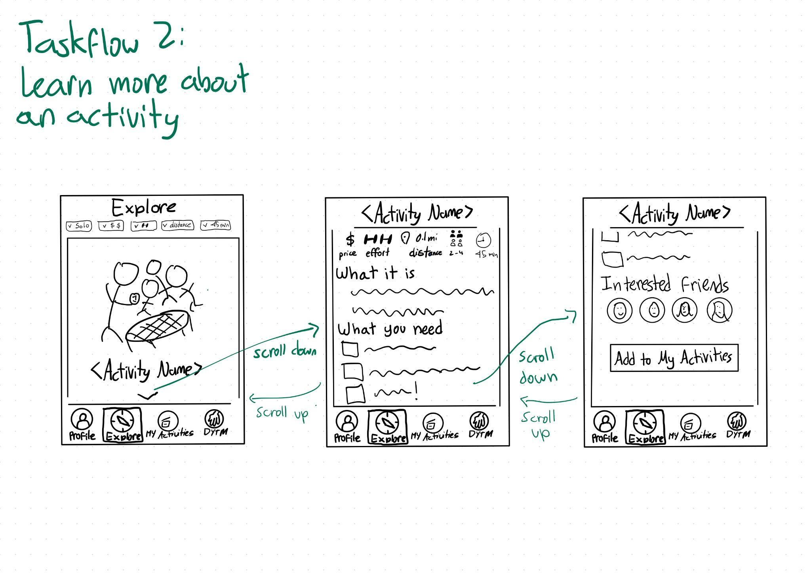

Slide 23
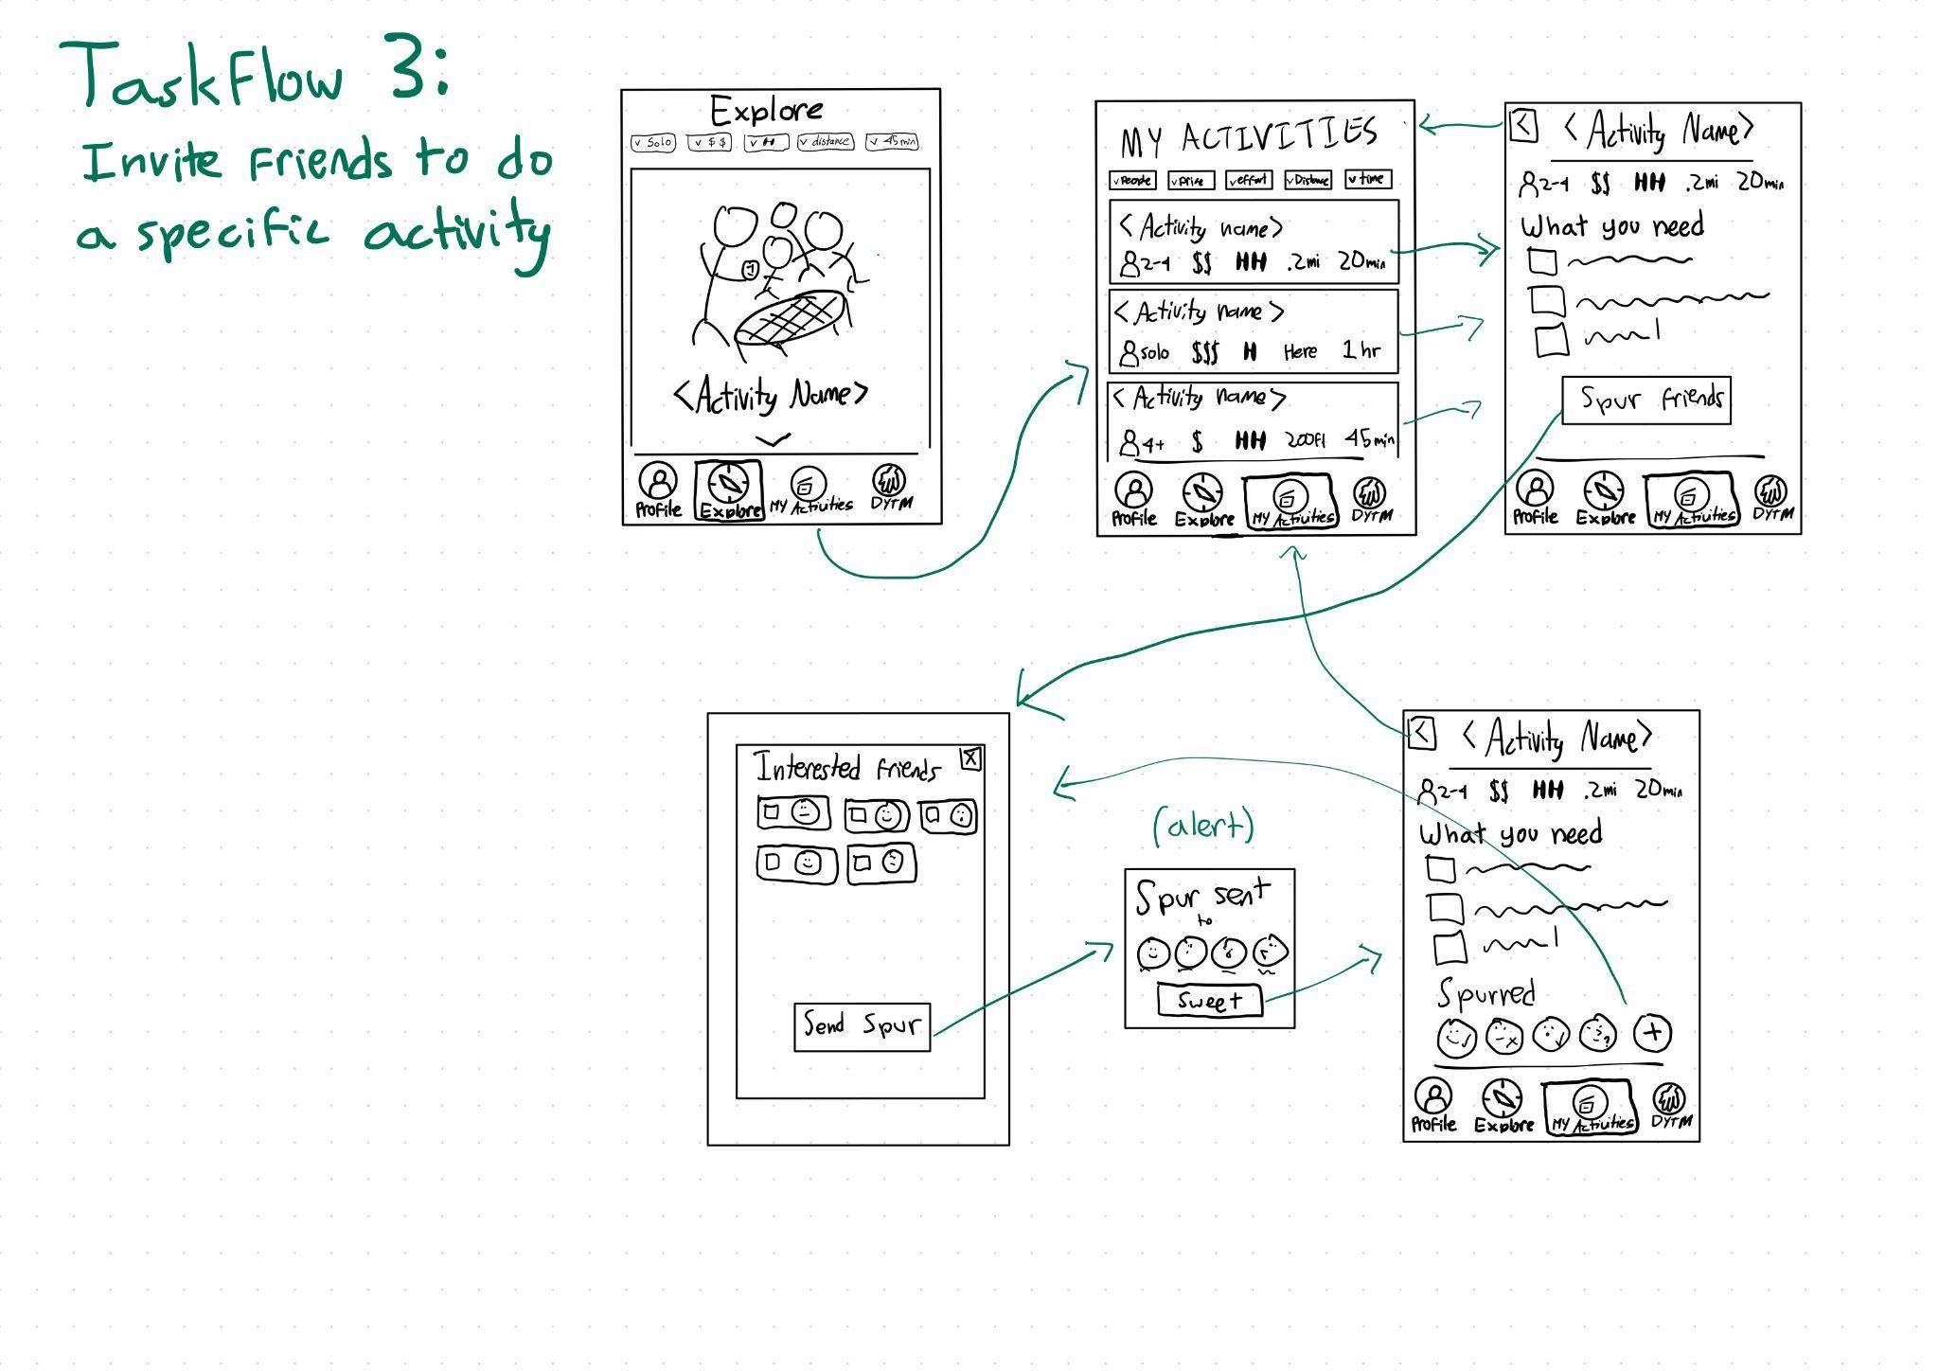

Slide 24
Testing
Methodology
4.1

Slide 25
Testing Methodology
Participants
Serena
Igor
Silvio
Valerie Stroke
Environment
Tressider
Procedure
3 tasks + 1 open-ended:
Find an activity you are interested in, get more information on it, and save it
View an activity you've saved
Invite friends to join in an activity
Is there anything else you want to do/explore?
Computer: Nils
Facilitator: Hannah
Notetaker: Simran

Slide 26
Usability Goals
Do users understand the swiping functionality?
Do we have enough signifiers in our app design to clue users that they can swipe to accept or reject an activity?
Does the information architecture make sense?
Task #3 - invite friends to join an activity with you - lives inside of an activity that you have saved in your My Activities. Are they able to find that functionality?
Do users understand & like "Do you trust me?"
Without onboarding, what do users think when they click the "do you trust me" button? Does the app's response (showing a random activity) make sense to them?

Slide 27
Testing
Results
4.2

Slide 28
Usability Goals
Do users understand the swiping functionality?
No! Though most explored scrolling, they didn't explore swiping. In later tests, we demonstrated the scrolling functionality and "peeks" of the check and cross for the right and left swipe. We felt like this was a factor of the paper prototype.
Does the information architecture make sense?
Not exactly. Users didn't always realize that their saved activities were clickable, or they would try to invite people from the Explore page before saving an activity.
Do users understand & like "Do you trust me?"
DTYM is a wildcard. Without onboarding and explicit explanation, it didn't make sense. Also, many users clicked on it because it was strange and interested, but hadn't saved enough activities for us to show them a random activity from their saved ones.

Slide 29
Other observations
All users immediately understood "my activities" button
Most users got stuck on the opening "explore" page, not realizing they were already viewing a potential activity
Users have differing opinions of the verb "Spur" to invite friends:
  English as second language users: didn't understand word Spur
  Linguist: Loved the colocation of "Spur" + "of the moment"
Users conflicted on "interested friends"
  Tester 1 loved that the app encouraged you to meet people
  Tester 3 very skeptical of how the app knows your friends

Slide 30
Takeaways
DYTM feature definitely needs onboarding, may get rid of it entirely
Swiping motion needs clearer signaling: replace with buttons or have users swipe in a tutorial
Lean into things users liked:
  connection with other people
  being presented with surprising activities (corn maze) and low-cost activities (book club)
More general theme: can we balance the fun of discovering parts of the app whale preventing users from becoming frustrated?

Slide 31
Appendix

Slide 32
Script
Our app is targeted at the time in your day where you might be scrolling on your phone, knowing you want to do something else but not sure what to do. We are testing our design, so we are going to ask you to complete some tasks within the app, but not tell you how. So please narrate your thinking, any questions, any frustrations, because those are on us as designers to fix! Assume you already have an account. The first task we'd like you to complete: Find an activity you are interested in, get more information on it, add it to your activities.
Second task: View an activity you’ve saved.
Third task: Invite friends to join in an activity.
Is there anything else you want to do or explore?

Slide 33
Testing Procedure Modifications
After the first 2 testers, we realized that most users were not sure they could scroll due to the appearance of the paper prototype. They also never thought about swiping. Since many swipe-based apps include a tutorial where it encourages you to swipe on the cards, we decided to include a tutorial where we showed how to scroll and swipe in the paper prototype for the latter 2 testers.

Slide 34
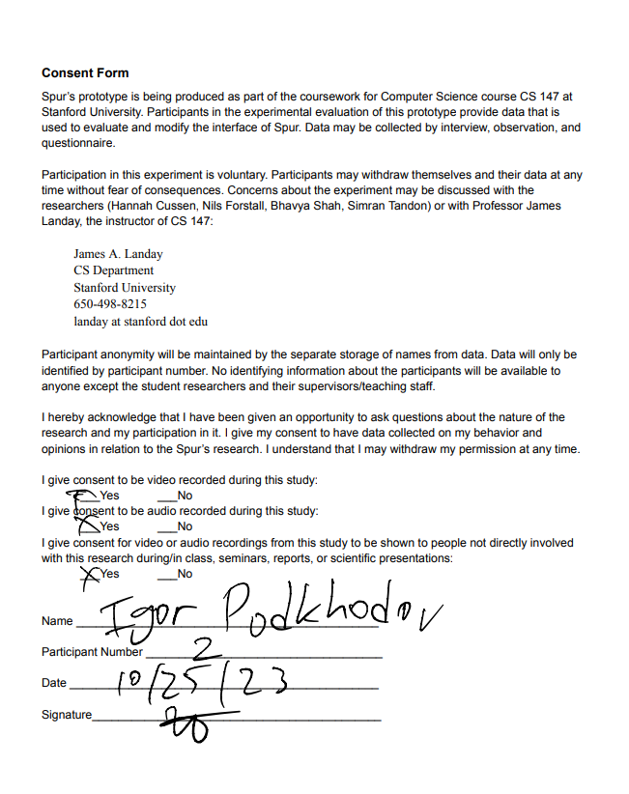
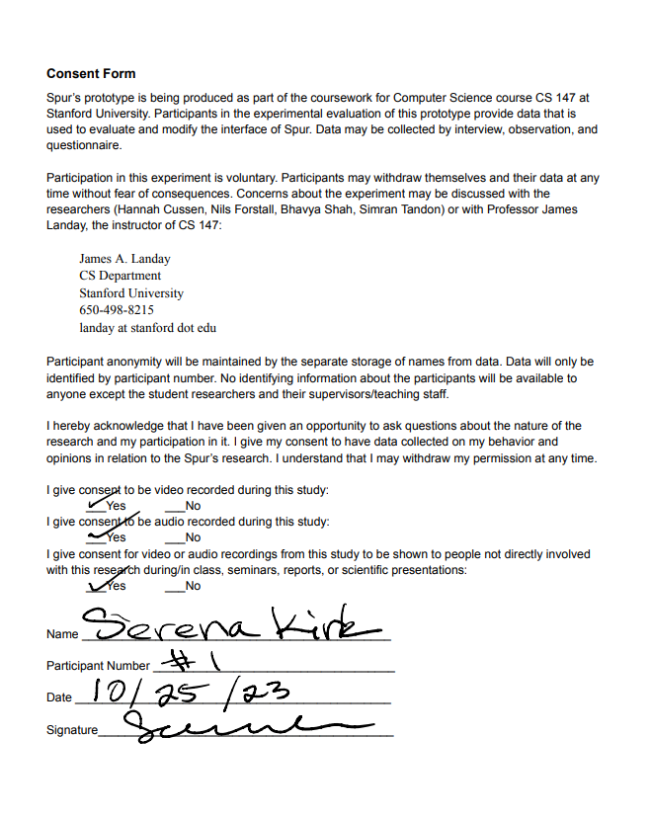

Slide 35
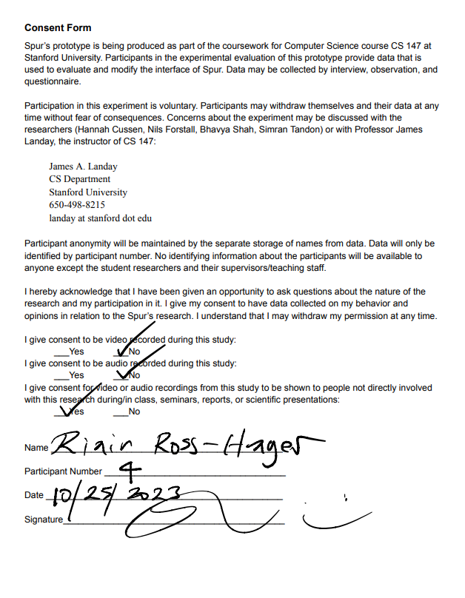
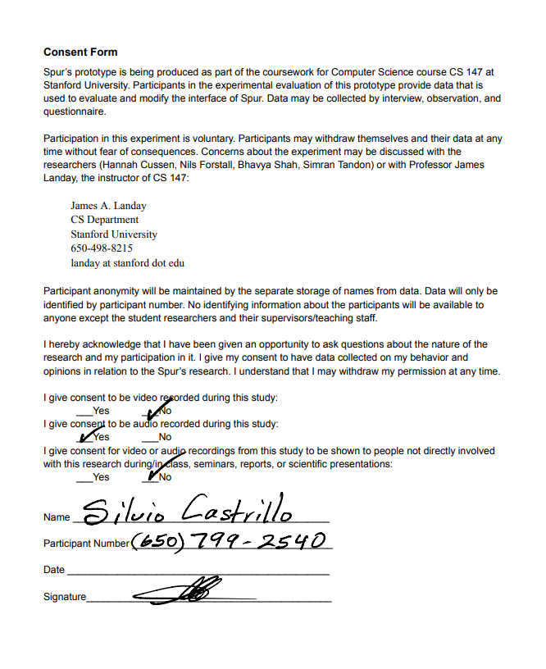

Slide 36
Incident Log
Click here to view

Slide 38
Credits.
Illustrations and Presentation Template: SlidesMania
Images: Unsplash
Fonts used in this presentation: Darker Grotesque and Ribeye

Slide 39
Editable Icons

